Slide 1






INSTAGRAM
TECH INFLUENCER
ANALYSIS
By Rohini Kadam

Slide 2

CONTENT
1.OVERVIEW
2.PROBLEM STATEMENT & DATASET
3. QUESTIONS,OUTPUT, INSIGHT & ACTIONABLE INSIGHT
4. RECOMMENDATION

Slide 3

1.OVERVIEW
The Tech Instagram Influencer’s account analysis.
The project involves analyzing three database tables containing Instagram activity data.

Slide 4

Explore this data, answer key questions, and create actionable insights.
Given Dataset : gdb0120.sql
Database containing 3 tables. dim_date, fact_account, fact_content.
2.PROBLEM STATEMENT & DATASET

Slide 5

Q1. How many unique post types are found in the 'fact_content' table?
Output :
Insight:
The dataset contains 4 unique post types in the fact_content table, highlighting content format diversity that influences engagement and performance.
Actionable Insights :
Identify the top-performing post type based on engagement metrics and focus on scaling that format to maximize audience interaction and performance.

Slide 6
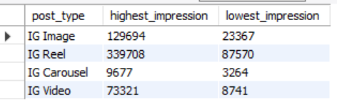
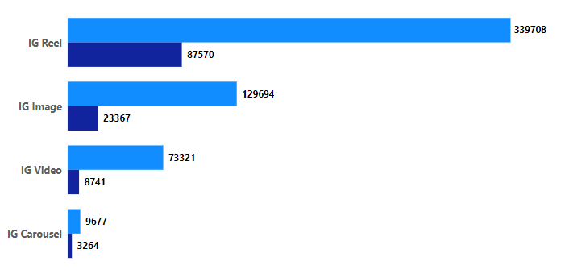
Q2. What are the highest and lowest recorded impressions for each post type?
Output :

Slide 7
Insight :
IG Reels have the highest impressions (339,708), while IG Carousel has the lowest (3,264), showing that Reels perform much better than other post types.
Actionable Insights :
Focus on creating more IG Reels content to leverage its high impressions, while reducing or optimizing IG Carousel posts to improve their performance and engagement.

Slide 8
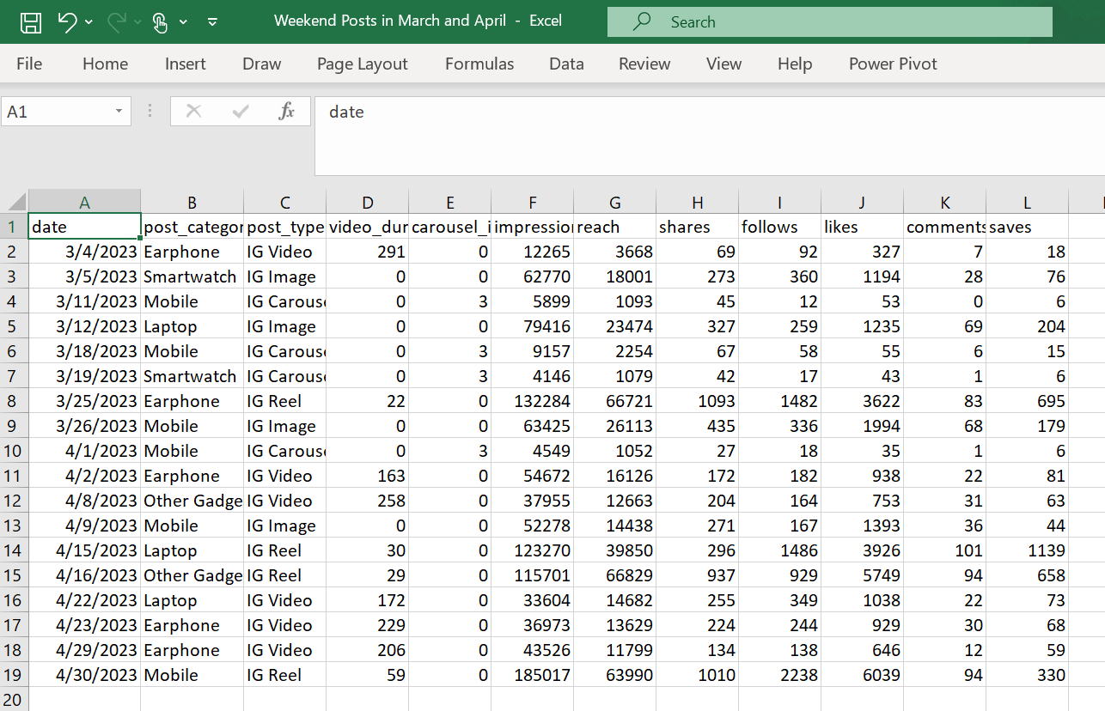
Q3. Filter all the posts that were published on a weekend in the month of March and April and export them to a separate csv file.
Output :

Slide 9
Insight :
A total of 18 posts were published on weekends in March and April, featuring a mix of post types like IG Video, IG Image, IG Carousel, and IG Reel. Notably, IG Reels and IG Videos consistently generated higher impressions and engagement compared to other formats.
Actionable insight :
Focus on creating more IG Reels and IG Videos for weekends to boost impressions and engagement.

Slide 10
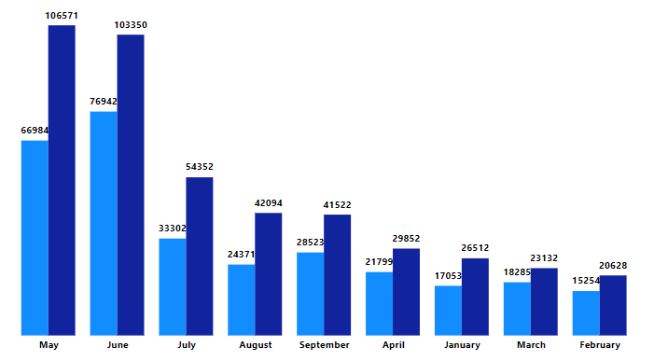
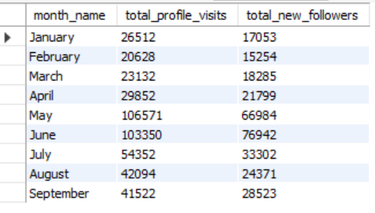
Q4. Create a report to get the statistics for the account. The final output includes the following fields:
• month_name
• total_profile_visits
• total_new_followers
Output :

Slide 11
Insight :
May and June stand out with the highest total profile visits (106,571 and 103,350) and new followers (66,984 and 76,942) respectively. This indicates peak months of engagement, while February recorded the lowest activity.
Actionable Insight:
Focus on replicating strategies from May and June in other months to boost engagement and follower growth.

Slide 12
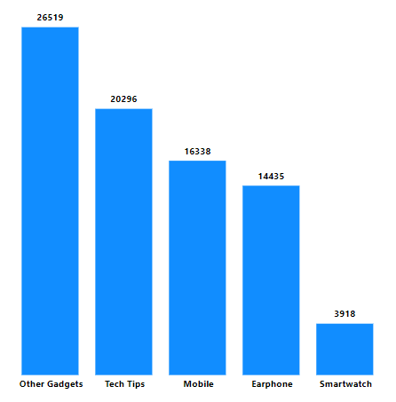
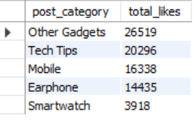
Q5. Write a CTE that calculates the total number of 'likes’ for each 'post_category' during the month of 'July' and subsequently, arrange the 'post_category' values in descending order according to their total likes.
Output :

Slide 13
Insight :
The Other Gadgets category is the most liked in July, outperforming others significantly.
Categories like Smartwatch and Earphone have relatively fewer likes, indicating lower engagement or interest.
Insight :
Boost High Performers: Create more content for Other Gadgets and Tech Tips to sustain engagement.
Revamp Low Performers: Identify issues with Smartwatch and Earphone content and try new formats or targeting.
Leverage Trends: Analyze top-performing content strategies and apply them to underperforming categories.

Slide 14
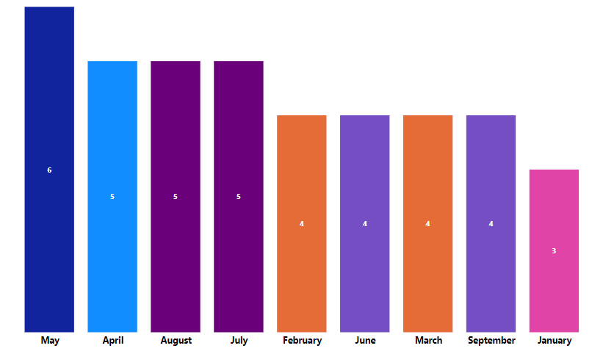
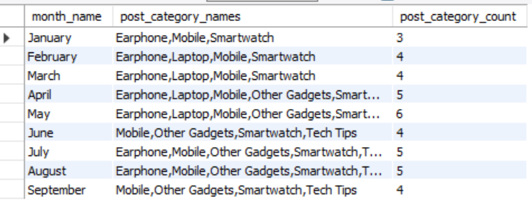
Q6. Create a report that displays the unique post_category names alongside their respective counts for each month. The output should have three columns:
• month_name
• post_category_names
• post_category_count
Eg: 'April', 'Earphone,Laptop,Mobile,Other Gadgets,Smartwatch', '5'
'February', 'Earphone,Laptop,Mobile,Smartwatch', '4'
Output :

Slide 15
Insight:
Focus on Mobile, Smartwatch, and Other Gadgets as they consistently perform well. Diversify content with Tech Tips to maintain engagement and adapt to seasonal trends.
Actionable Insight :
Focus on Mobile, Smartwatch, and Other Gadgets to engage the audience, and incorporate Tech Tips for content diversification. Monitor seasonal trends, especially in May and July, to adjust content strategies accordingly.

Slide 16
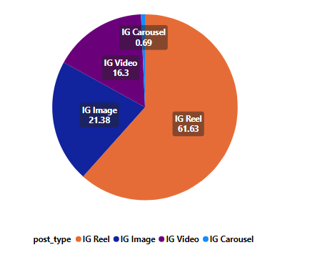
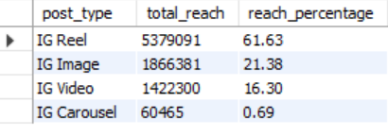
Q7. What is the percentage breakdown of total reach by post type? The final output includes the following fields:
• post_type
• total_reach
• reach_percentage
Output :

Slide 17
Insight :
The majority of the reach (61.63%) comes from IG Reels, indicating that this post type is the most effective for reaching a broader audience.
Actionable Insight:
Focus more on creating and promoting IG Reels to maximize reach, while optimizing IG Image and Video content for engagement.

Slide 18
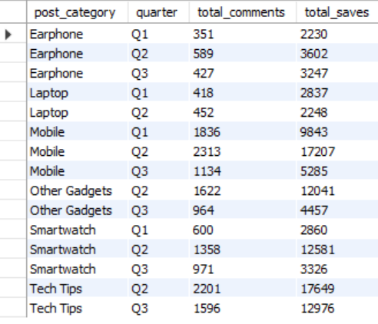
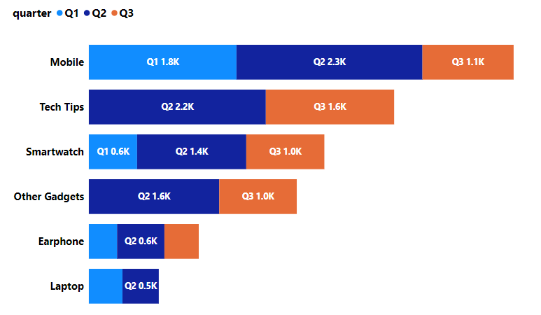
Q8. Create a report that includes the quarter, total comments, and total saves recorded for each post category. Assign the following quarter groupings:
(January, February, March) → “Q1”
(April, May, June) → “Q2”
(July, August, September) → “Q3”
The final output columns should consist of:
• post_category
• quarter
• total_comments
• total_saves
Output :

Slide 19
Insight:
Mobile category has the highest total comments and saves across all quarters, especially in Q2, where the number of saves (17,207) stands out significantly.
Tech Tips and Other Gadgets show high engagement in Q2, suggesting the possibility of seasonality or trending topics during this period.
Actionable Insights:
Focus marketing and content efforts on Mobile, especially in Q2, which sees a peak in both comments and saves.
Explore Tech Tips content in Q2 and Q3 to leverage high engagement periods and enhance reach.

Slide 20
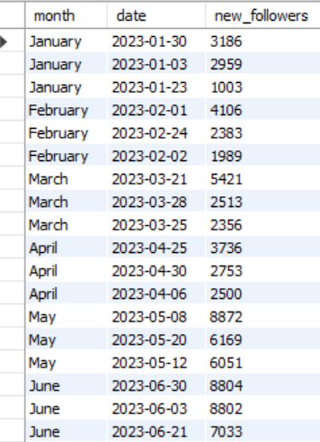
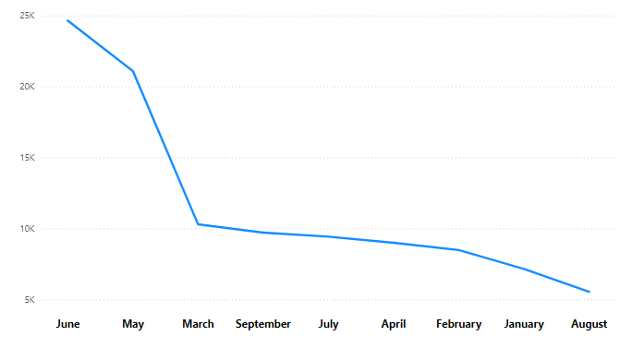
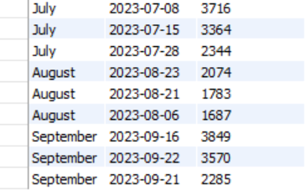
Q9. List the top three dates in each month with the highest number of new followers. The final output should include the following columns:
• month
• date
• new_followers
Output :

Slide 21
Insight:
Peak New Followers: May and June stand out with significantly higher new follower counts, indicating successful campaigns or posts.
Consistent Highs: March and April also show consistently high engagement, especially with the top three dates.
Actionable Insights:
Replicate Success: Review the content and strategies for the top-performing days in May and June to identify patterns that led to the higher follower count.
Campaign Timing: Focus efforts on days similar to the high-performing dates to leverage the momentum during peak engagement times.

Slide 22
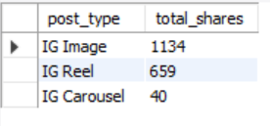
Q10. Create a stored procedure that takes the 'Week_no' as input and generates a report displaying the total shares for each 'Post_type'. The output of the procedure should consist of two columns:
• post_type
• total_shares
Output : for input_week_no = W1

Slide 23
4. RECOMMENDATION
Replicate successful content strategies from peak days to maximize follower growth.
Leverage seasonal trends by planning campaigns around high-performance months.
Engage actively on high-follower days to retain new followers and boost loyalty.
Experiment with content types that perform well on top follower days to refine strategies.

Slide 24
THANK YOU!

